Slide 1
Scientific Research in Information Systems
Chapter 5
MIXED METHODS AND DESIGN SCIENCE METHODS
JAN RECKER

Slide 2
Overview
Mixed Methods and Design Science Methods
Mixed Methods
Design Science Methods

Slide 3
Mixed Methods
Is type of inquiry that features combinations of both qualitative and quantitative methods for data collection and analysis in either sequential or concurrent fashion (“numbers and words”)
Emerged for two reasons:
It was developed as a response to the “paradigm wars” between qualitative and quantitative researchers.
It provided a pragmatic way of using the strengths of a pluralistic approach to research that combined the strengths of both qualitative and quantitative methods.
Encourages stronger inferences, to provide a greater diversity of divergent views and to enable researchers to simultaneously answer confirmatory and exploratory questions, verifying and generating theory at the same time.

Slide 4
Mixed Methods (Cont.)
There are a number of typologies for mixed method designs and they address several different dimensions of research:
Weighing, that is, deciding whether to give the quantitative and qualitative components of a mixed study equal status or to give one paradigm the dominant status;
Timing of the qualitative and quantitative phases – sequential or concurrent;
Mixing, which can form a continuum from mono-method to fully mixed
methods; and
Placing, that is, deciding where mixing should occur (in the research questions, methods of data collection, research methods, during data analysis, or data interpretation).

Slide 5
Mixed Methods (Cont.)
Five major rationales for conducting mixed method research:
Triangulation
Complementarity
Initiation
Development
Expansion
Notes:
Triangulation means you are seeking convergence and corroboration of results from different methods and designs studying the same phenomenon.
Complementarity refers to seeking elaboration, enhancement, illustration, and clarification of the results from one method with results from the other method.
Initiation means attempting to discover paradoxes and contradictions that lead to a re-framing of the research questions.
Development concerns using the findings from one method to help inform the other method, such that its usage plan is developmental in nature.
Expansion is a rationale that occurs if you are seeking to expand the breadth and range of research by using different methods for different inquiry components.

Slide 6
Mixed Methods (Cont.)
Particularities in mixed method research that warrants attention:
Data transformation: especially in concurrent mixed method research –employing qualitative and quantitative methods in parallel means that data needs to be transformed to suit the different analysis techniques. For example, qualitative data (e.g., codes) need to be quantified (e.g., by counting frequency of occurrence in text). Alternatively, quantitative data may need to be qualified to enable meaningful comparison.
Data correlation: data collected with different methods require comparison with a view to identifying outliers (e.g., in a quantitative survey) that require follow-up analysis with qualitative data.
Data comparison: one essential component in mixed method is constant comparison for purposes of triangulation. Often this is achieved through a data matrix that combines a quantitative axis and a qualitative axis. The objective is to identify similarities as well as differences – which would then require further investigation to examine the cause of difference.
Legitimation: A key activity is the description of the steps undertaken to ensure the validity of quantitative data as well as accuracy of qualitative findings.
Notes:
The processes of data collection and analysis depend on the type of methods being employed, and in general follow the guidelines for the techniques chosen. Still, a number of particularities exist in mixed method research that warrants attention:

Slide 7
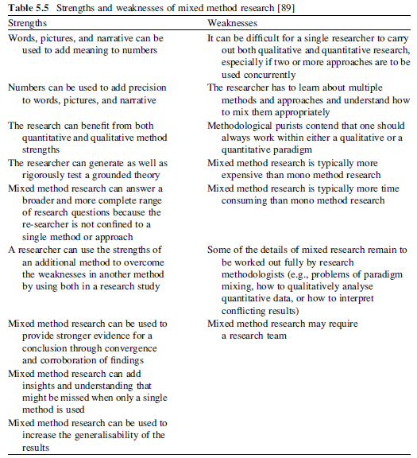
Mixed Methods (Cont.)

Slide 8
Design Science Methods
The main motivation behind the (re-) emergence of design science as a research paradigm is said to stem from a desire to complement the mainstream behavioural orientation of information systems research with more design-oriented research.
Design science research has been defined ([82], p. 5) as
a research paradigm in which a designer answers questions relevant to human problems via the creation of innovative artefacts, thereby contributing new knowledge to the body of scientific evidence. The designed artefacts are both useful and fundamental in understanding that problem.
The fundamental principle is that that knowledge and understanding of a design problem and its solution are acquired in the building and application of an artefact.

Slide 9
Design Science Methods (Cont.)
The term artefact is central to design science research and is used to describe something that is artificial, or constructed by humans, as opposed to something that occurs naturally.
The interest is on artefacts that improve upon existing solutions to a problem or perhaps provide a first solution to an important problem.
At least five types of artefacts are differentiated:
Constructs (vocabulary and symbols)
Models (abstractions and representations)
Methods (algorithms and practices)
Instantiations (implemented and prototype systems)
Design theories (improved models of design, or design processes)

Slide 10
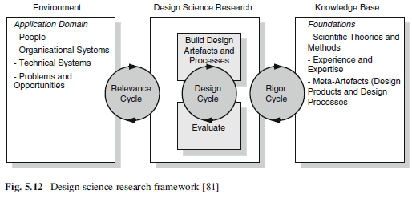
Design Science Methods (Cont.)
Notes:
In examining how such artefacts can be developed, design science research can be placed within a framework bounded by the practical environment and the available knowledge base at that point in time. This framework is shown in Fig. 5.12.
The environment defines the problem space in which the phenomena of interest reside.
The knowledge base provides the materials from and through which design science research is accomplished.
Design science research is comprised of activities related to building and evaluating artefacts designed to meet the identified business needs.
The relevance cycle bridges the contextual environment of the research project with the design science activities.
The rigor cycle connects the design science activities with the knowledge base of scientific foundations, experience, and expertise that informs the research project.
The central design cycle iterates between the core activities of building and evaluating the design artefacts and processes of the research.

Slide 11
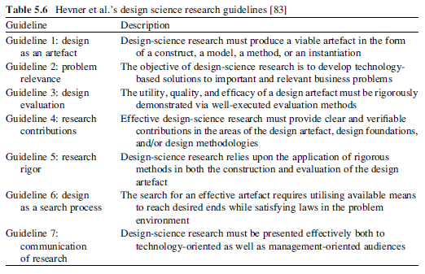
Design Science Methods (Cont.)
Notes:
Alan Hevner and his colleagues identified seven high-level guidelines that give guidance in the form of key principles to which design science research adheres.

Slide 12
Design Science Methods (Cont.)
Three Key challenges:
First key challenge is the notion of demonstrated utility that the design artefact provides
Demonstrated utility means specifically that utility is illustrated in such a way that utility is improved beyond the current state of utility. This definition also implies three key criteria that should be met:
Novelty of the demonstrated utility of an artefact
A positive difference of the utility of an artefact in comparison to existing work;
A thorough evaluation that provides decisive evidence for superior utility of an artefact.
Second key challenge of design science research can be epitomised in the question “when is a design a research contribution?”
The answer lies in the contribution to academic knowledge that is inherent in the design – both as a process and as an outcome.
Third challenge lies in the role of theory and design science.
Notes:
A third challenge lies in the role of theory and design science. One can argue that the goal of design science is all about efficacy and utility; there is no theory being sought. Hence, theory can be regarded as unimportant to such endeavours. One may also argue, however, that as researchers we can attempt to define the anatomy of what constitutes a good design theory. In that view, an artefact is seen as an instantiation (and thus a demonstration) of the theory, which then becomes the fundamental component of the design research.

Slide 13
Further Reading
Creswell, J.W.: Research Design: Qualitative, Quantitative, and Mixed Methods Approaches, 3rd edn. Sage, Thousand Oaks (2009)
Tashakkori, A., Teddlie, C. (eds.): Handbook of Mixed Methods in Social and Behavioral Research. Sage, Thousand Oaks (2003)
Hevner, A.R., Chatterjee, S.: Design Research in information Systems: Theory and Practice. Springer, New York (2010)
Simon, H.A.: The Sciences of the Artificial, 3rd edn. MIT Press, Cambridge (1996)

Slide 14
Thank You
☺

